Slide 1
I/9. Using Dictionaries
Data Analyst Intermediate – PYTHON-based Data Analysis, Data Cleaning, Data Visualization & Predictions
Data Analyst Intermediate
Trainer: Szabolcs Jobbagy

Slide 2

Creating a Dictionary
Start a new notebook
We can create Dictionaries, to store related pairs of data
The Dictionary is within curly brackets { },
the items (key-value pairs) are separated by comma, and
within the item the key and value is separated by a colon :
# create a dictionary english_to_german = {'Year': 'Jahr', 'Month': 'Monat', 'Date': 'Datum'}
# create a dictionary personal_data = {'Name': 'Peter', 'Age': 36, 'Country': 'UK'}
# value for the key in the dictionary personal_data['Age']
# keys of the dictionary personal_data.keys()
# values of the dictionary personal_data.values()
# key-value pairs (items) of the dictionary personal_data.items()

Slide 3
Looping through a Dictionary
We can use loops to iterate through a Dictionary
We can modify/add value by just assigning to the key
# modify value for a key in dictionary personal_data['Age'] = 30
# loop through the items of dictionary for i in personal_data: print(i, "-", personal_data[i])
# loop through the items of dictionary for key, value in personal_data.items(): print(key, "-", value)
# add a new item (key-value pair) to the dictionary personal_data['Height'] = 180

Slide 4
Pairing Lists into a Dictionary
zip(list1, list2): the items of given lists can be "paired" into pairs ("tuples")
Then we can create a dictionary from these pairs:
dict( zip(list1, list2) )
namelist = ['Jack', 'Jill', 'Susan'] agelist = [34, 25, 28] # create dictionary from the lists names_ages = dict( zip(namelist, agelist) )

Slide 5


Removing duplicates from Lists with Dictionary
Items in a Dictionary CANNOT have duplicates, items are changeable, and the items are ordered (from Python 3.7, in earlier versions they are unordered)
Thus, if we convert a List into a Dictionary, and then back into a List, the repetitive/duplicate items disappear
dict.fromkeys(list): convert a List into a Dictionary
To check Python version, import the „python_version” method from the „PLATFORM” module
namelist = ['Jack', 'Jill', 'Susan', 'Jill', 'Jack'] dict.fromkeys(namelist)
namelist = ['Jack', 'Jill', 'Susan', 'Jill', 'Jack'] # remove duplicates from list namelist_unique = list( dict.fromkeys(namelist) ) namelist_unique
from platform import python_version print(python_version())

Slide 6
I/10. Data Analysis, Data Transformation AND Data Cleaning with Pandas III.
Data Analyst Intermediate – PYTHON-based Data Analysis, Data Cleaning, Data Visualization & Predictions
Data Analyst Intermediate
Trainer: Szabolcs Jobbagy

Slide 7

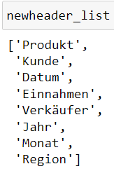
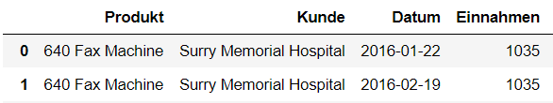


Renaming Dataframe columns or data with Dictionary
Continue "Filter_file_by_parameters"
Create a dictionary of the headers and translate headers
column/series.replace(dictionary): rename, translate column/series values based on the dictionary
Check the finally exported file
dfp_headers = paramlist_filt[3]
# add column values to list oldheader_list = dfp_headers['Old header'].tolist() newheader_list = dfp_headers['New header'].tolist()
# create dictionary from the lists header_dict = dict(zip(oldheader_list, newheader_list)) # translate headers based on dictionary df.columns = pd.Series(df.columns).replace(header_dict)
# translate column values based on dictionary header_dict2 = dict( zip(['North', 'East', 'South', 'West'], ['Nord', 'Ost', 'Süd', 'West']) ) df['Region'] = df['Region'].replace(header_dict2)

Slide 8



Looping through columns
Copy "Filter_file_by_parameters": "Filter_multiple_files_by_parameters"
Change base data
We want to clean and filter ALL the input files in the 1st parameter table, looping through them
Delete lines where we wrote out data to cell output
Convert region translating part to comment
for column_name, data in df.iteritems(): (it is deprecated!) for column_name, data in df.items(): looping through a dataframe's COLUMNS
data[rowindex]: column's value in the given row
dfp_headers = paramlist[3] # headers
# loop through the dataframe columns for column_name, data in dfp_headers.items(): # print data in the first 3 rows print(column_name, ":", data[0], data[1], data[2])

Slide 9

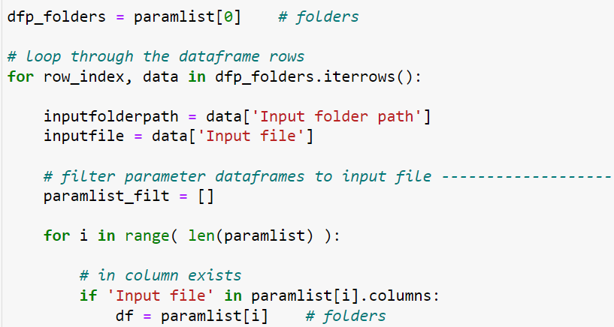
Looping through rows
for row_index, data in df.iterrows(): looping through a dataframe's ROWS
data[columnname]: row's value in the given column
In the notebook, select the cells for the main source files by Shift+Down Arrow, and merge them: Shift+M
The remaining lines in the cell should be selected and indented by TAB (due to the FOR loop)
dfp_folders = paramlist[0] # folders # loop through the dataframe rows for row_index, data in dfp_folders.iterrows(): # print data in the first 2 columns print(row_index, ":", data['Input file'], data['Input folder path'])
dfp_folders = paramlist[0] # folders # loop through the dataframe rows for row_index, data in dfp_folders.iterrows(): inputfolderpath = data['Input folder path'] inputfile = data['Input file']

Slide 10

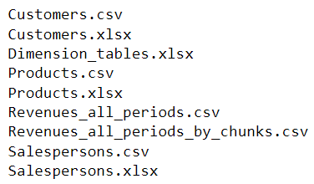
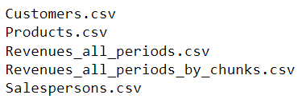

Looping through certain files
Continue "Conditionals_and_loops"
for filename in os.listdir(folder): looping through files of a folder
import os inputfolderpath = r'D:\Trainings\Cubix\Python_DA\Output\All periods' # loop through files of a folder for filename in os.listdir(inputfolderpath): print(filename)
for filename in os.listdir(inputfolderpath): # if file name contains substring if filename.find('.csv') >= 0: print(filename)
for filename in os.listdir(inputfolderpath): # if file name contains multiple substrings if filename.find('.csv') >= 0 and filename.lower().find('rev') >= 0: print(filename)

Slide 11

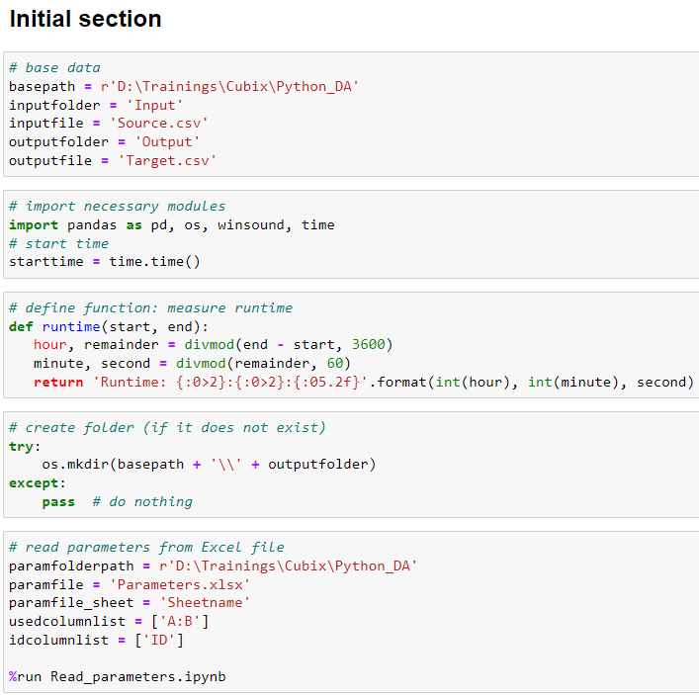
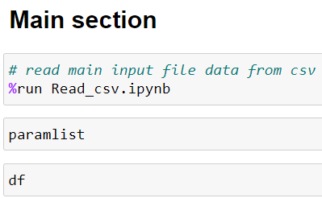
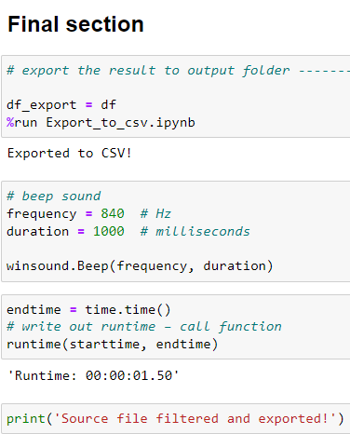
Creating template programs
Copy "Filter_multiple_files_by_parameters": "Template"
Delete the specific middle part of the code, leave only the beginning and the end, to have a Template program for many of our projects
This program can be developed, extended in the future
We can create Templates for different types of projects, tasks

Slide 12

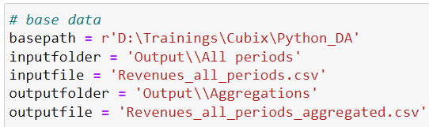
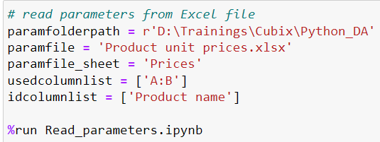
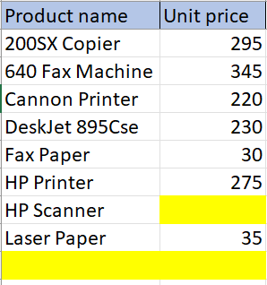
Calculating with column values
Copy "Template": "Calculations_aggregations"
Read the parameter table from file "Product unit prices.xlsx", and read main input file data
Look up the unit prices of the Products into a separate column ("Unit price") LEFT join (data may be missing in param file)
Calculate the number of units sold ("Sold quantity") by dividing Revenue with the Unit price
It can show an error message if there are missing values (NaN) in the columns, and the result can also be NaN
# merge 2 dataframes - left join df = pd.merge(df, paramlist[0], left_on = 'Product', right_on = 'Product name', how = 'left')
# calculate sold quantity df['Sold quantity'] = df['Revenue'] / df['Unit price']

Slide 13
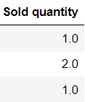



Missing (blank) values in columns
column.isnull(): the rows where there is missing (blank) column value
We can slice the dataframe to any column's values whose rows is blank at another column, and then we can add them to a List
As the List can have duplicates, we remove duplicates
In the "Product unit prices.xlsx", add unit price to "HP Scanner": 220, and add new product "MW Copier" with 220 unit price
Now the division does not get an error
# missing values in column missingproducts = list(df.loc[ df['Product name'].isnull(), 'Product' ]) missingproducts = list( dict.fromkeys(missingproducts) ) print('Missing products:', missingproducts)
# missing values in column missingprices = list(df.loc[ df['Unit price'].isnull(), 'Product' ]) missingprices = list( dict.fromkeys(missingprices) ) print('Missing unit prices:', missingprices)

Slide 14


Aggregating column values (sum, average etc.)
We can do aggregations on the Dataframe columns (sum, average, count, min, max …)
# aggregate a column's values average_qty = df['Sold quantity'].mean() min_qty = df['Sold quantity'].min() max_qty = df['Sold quantity'].max() count_qty = df['Sold quantity'].count() sum_qty = df['Sold quantity'].sum() average_qty, min_qty, max_qty, count_qty, sum_qty
# aggregate a column's values average_rev = df['Revenue'].mean() min_rev = df['Revenue'].min() max_rev = df['Revenue'].max() count_rev = df['Revenue'].count() sum_rev = df['Revenue'].sum() average_rev, min_rev, max_rev, count_rev, sum_rev

Slide 15
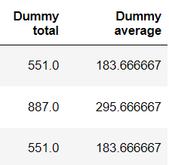
Aggregating row values
We can do aggregations (sum, average …) on the rows as well
columnlist = ['Revenue', 'Unit price', 'Sold quantity'] # sum of multiple columns' values into new column df['Dummy total'] = df[columnlist].sum(axis = 1)
columnlist = ['Revenue', 'Unit price', 'Sold quantity'] # average of multiple columns' values into new column df['Dummy average'] = df[columnlist].mean(axis = 1)
# delete multiple columns df = df.drop(['Dummy total', 'Dummy average'], axis = 1)

Slide 16
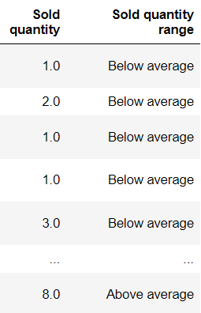
Add ranges for values
In a separate column („Sold quantity range”) add ranges for sold quantities (like "VLOOKUP" formula in Excel with range lookup)
# insert new column df['Sold quantity range'] = df['Sold quantity']
# change values of a column based on another column's values df.loc[ df['Sold quantity'] >= average_qty, 'Sold quantity range' ] = 'Above average' df.loc[ df['Sold quantity'] < average_qty, 'Sold quantity range' ] = 'Below average'

Slide 17
Aggregation by groups – Pivot table
We can create Pivot tables in Pandas, with the help of the "NumPy" library (which is used for faster calculating with arrays, matrices etc.)
pd.pivot_table(df): creating a pivot table
index: fields in the "row" area (left edge)
columns: fields in the "column" area (top edge)
values: fields in the "values" area (in the middle)
aggfunc: aggregating function (np.sum …)
fill_value: value to replace missing values with (after aggregation)
# import numpy library, which is used for working with arrays, matrices etc. import numpy as np # create a pivot table pivot_sum_rev = pd.pivot_table(df, values = 'Revenue', index = ['Customer'], columns = ['Product'], aggfunc = np.sum) pivot_sum_rev
pivot_sum_rev = pd.pivot_table(df, values = 'Revenue', index = ['Customer'], columns = ['Product'], aggfunc = np.sum, fill_value = 0)

Slide 18
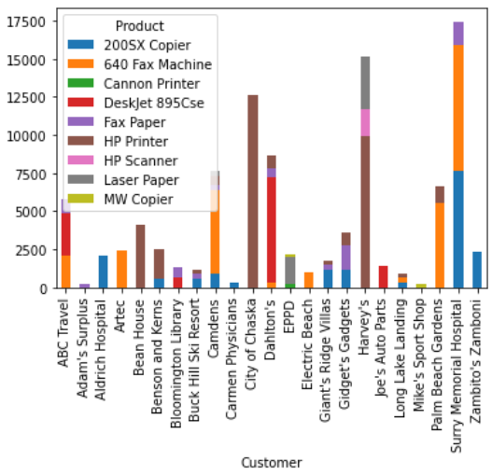
Creating charts
df.plot(): create chart/plot with Pandas
kind: chart type ('bar': column or vertical bar, 'barh': horizontal bar, 'line', 'pie', 'scatter', 'area', 'hist', 'box' …)
stacked = True: stacked chart type
figsize = (width, height): size of the chart in inches
# create a stacked column chart pivot_sum_rev.plot(kind = 'bar', stacked = True)
# create a stacked bar chart pivot_sum_rev.plot(kind = 'barh', stacked = True)
# create a pivot table pivot_sum_rev2 = pd.pivot_table(df, values = 'Revenue', index = ['Product'], aggfunc = np.sum) # create a line chart pivot_sum_rev2.plot(kind = 'line', figsize = (15, 5))

Slide 19

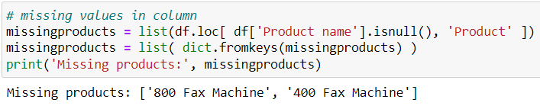
Finding differences between tables
Copy "Calculations_aggregations": "Check_differences"
Copy the Revenues_all_periods.csv file in ……Output\All periods folder -> Revenues_all_periods2.csv
Open it in Notepad/Wordpad (NOT in Excel), and change the name of 2 products to non-existing, new names (e.g. 800 Fax Machine, 400 Fax Machine)
Change the inputfile name in base data
Run the program until showing missing products and missing unit prices, these will show the differences between the two tables
Delete all program cells for calculation/aggregation, pivot table and chart
To replace NaN values to any value: column.fillna(newvalue)
# replace NaN values to any value in column df['Unit price'] = df['Unit price'].fillna(0)

Slide 20
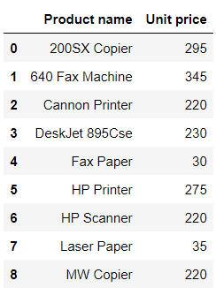

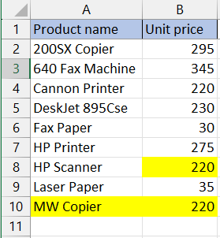
The last row index in an Excel table
As we can show the last row index of a dataframe by the shape[0], we can calculate the last row of the table in Excel
As the shape[0] does not include column header row, shape[0] + 1 results the last table row in Excel
If we want to add data into "Product unit prices.xlsx" file below the table, it's important to know its last row
paramlist[0]
# last row of table in Excel lastrow_excel = paramlist[0].shape[0] + 1

Slide 21
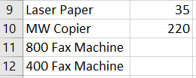
Writing to Excel files' specific cells
Send the new Products without unit prices into the "Product unit prices.xlsx" file (with the OPENPYXL library)
# library for writing into XLSX, XLSM files import openpyxl # load Excel workbook (wb) wb = openpyxl.load_workbook(paramfolderpath + '\\' + paramfile) # define worksheet (ws) ws = wb[paramfile_sheet]
i = 0 # for all items in missing products list for product in missingproducts: i += 1 # write data into specific cell of Excel sheet ws.cell(row = lastrow_excel + i, column = 1).value = product # save Excel file (it will also close it) wb.save(paramfolderpath + '\\' + paramfile)

